Slide 1
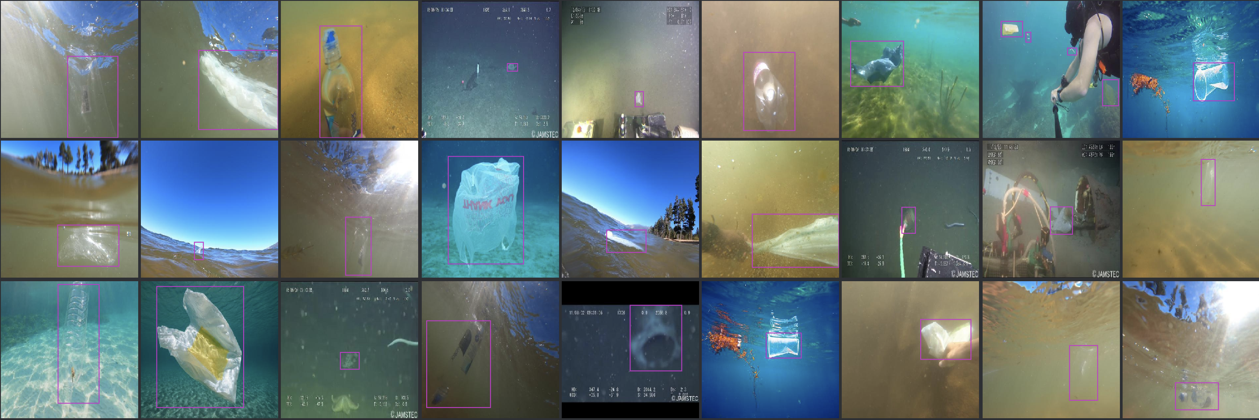
Marine Trash Detection
Nasibah (Nosayba) Azhari

Slide 2
PROBLEM
8 millions tons of trash dumped in the ocean annually.
Causes damage to:
Marine life.
Economies.
Tourism.
Human health. It’s easy to find target trash near the water surface, but it’s difficult to find trash near the ocean floor.
Dependance on human manual removal is limiting.

Slide 3
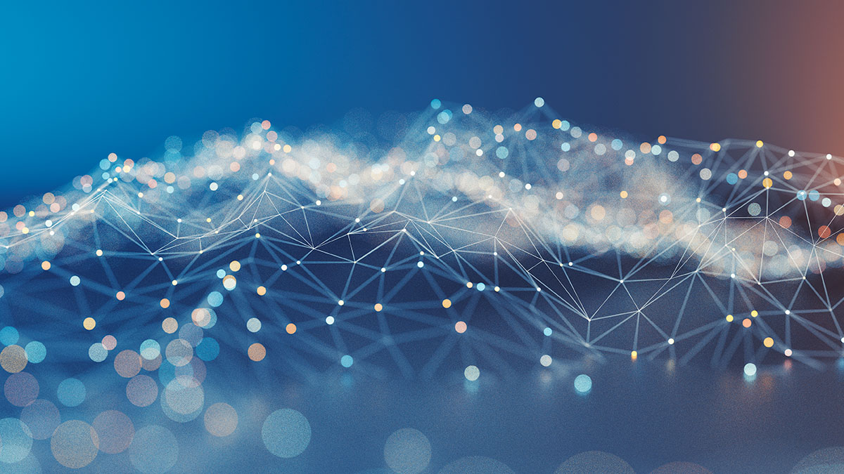
PROPOSED SOLUTION
A cleaning robot that detects and removes trash in the ocean.
This project is an attempt at the first step: an object detection model that detects the trash.

Slide 4
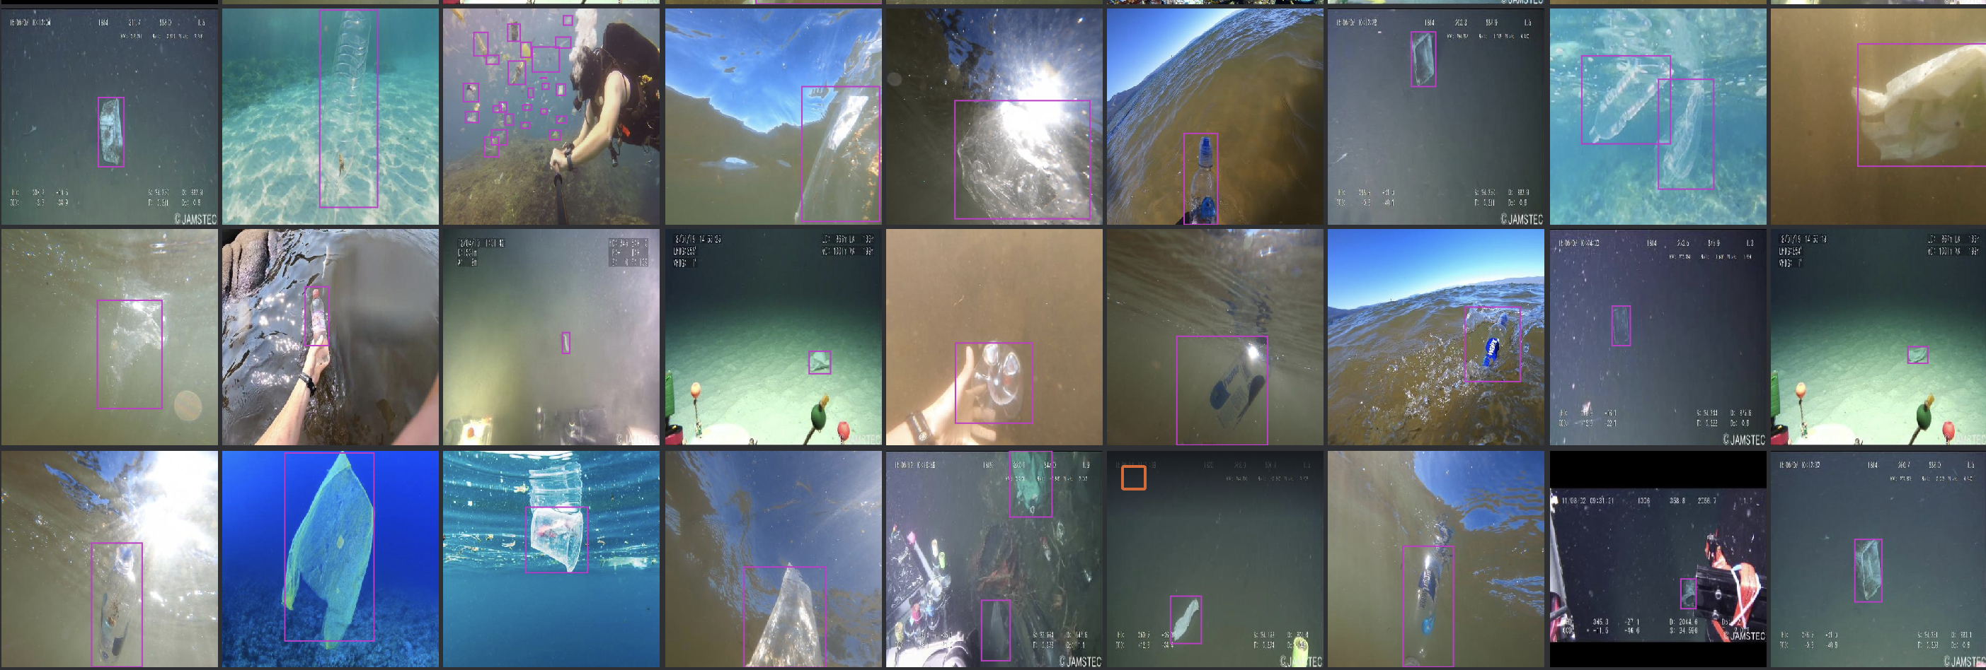

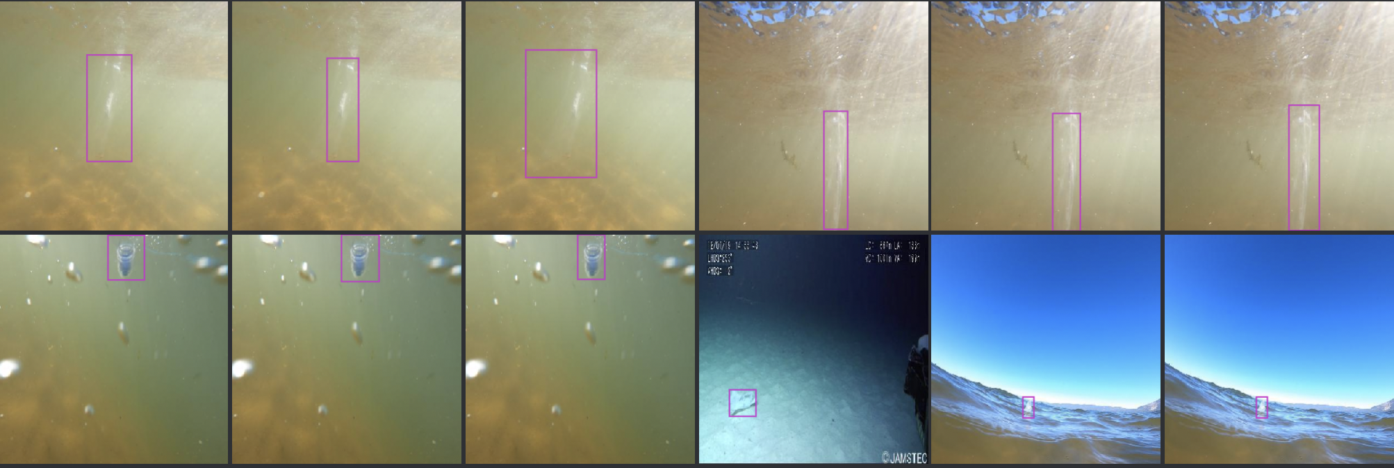
PROJECT PIPELINE
RESULTS
Pre-trained baseline model - R50-FPN
DATASET COLLECTION AND RE-FORMATTING
REMOVING DUPLICATES AND NEAR DUPLICATES
ALGORITHM (TRANSFER LEARNING + TRAINING)

Slide 5
DATA COLLECTION
GitHub repo: github.com/gautamtata/DeepPlastic)
A labelled object detection dataset with bounding boxes.
Around ~1700 images were used for the training.
Sources:
Video frames filmed on a GoPro taken from Lake Tahoe, San Francisco Bay and Bodega Bay in CA – produced specifically for the model by the original dataset author.
Internet images (<20%) taken by scraping Google Images.
Deep Sea images are from JAMSTEK JEDI dataset: http://www.godac.jamstec.go.jp/

Slide 6
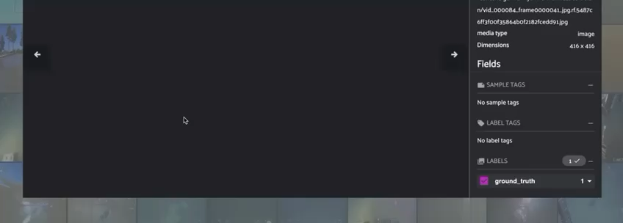

Slide 7
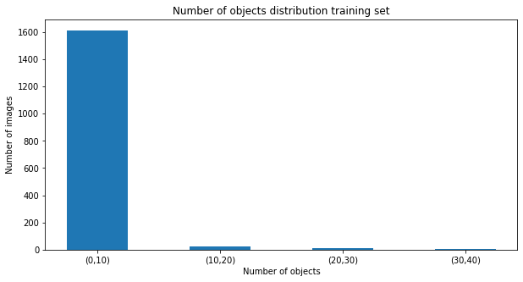
DISTRIBUTION OF BOUNDING BOXES
Note: there’s only one class in this dataset: plastic trash.

Slide 8
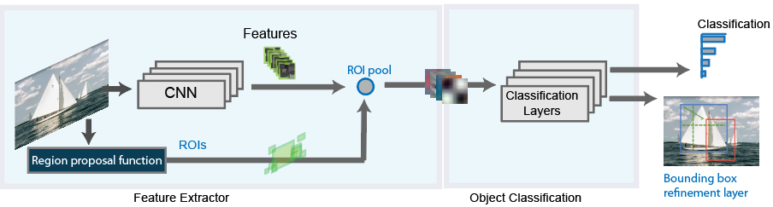
THE MODEL – FASTER R CNN
Notes:
Mention here why I chose it too

Slide 9
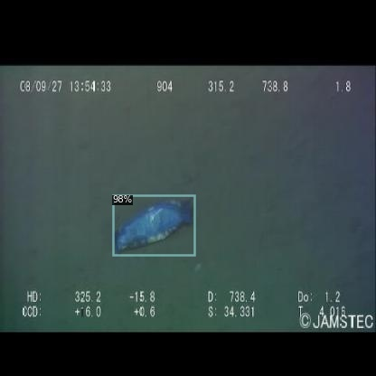
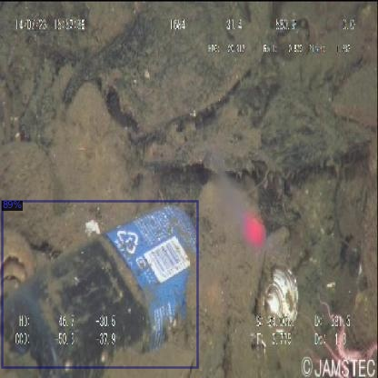
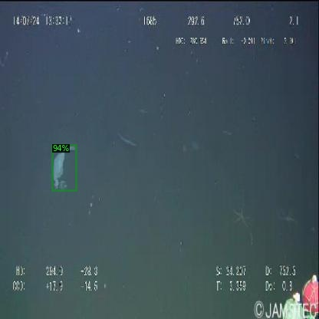
RESULTS

Slide 10
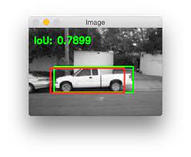
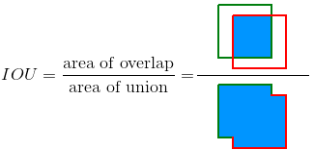
Understanding the mtrics
Average precision.
Average recall.
Intersection over union (IoU).
Notes:
This meant to basically give an overview so the next two slides make sense
Here explain the metrics roughly and how they relared to IoU
Make sure to discuss the limitations of those metrics and how there are some things they don’t tell us
Also mention I used a coco evaluator
Mention how IoU in this case is actually very important.. You don’t want it to pick at sea life

Slide 11
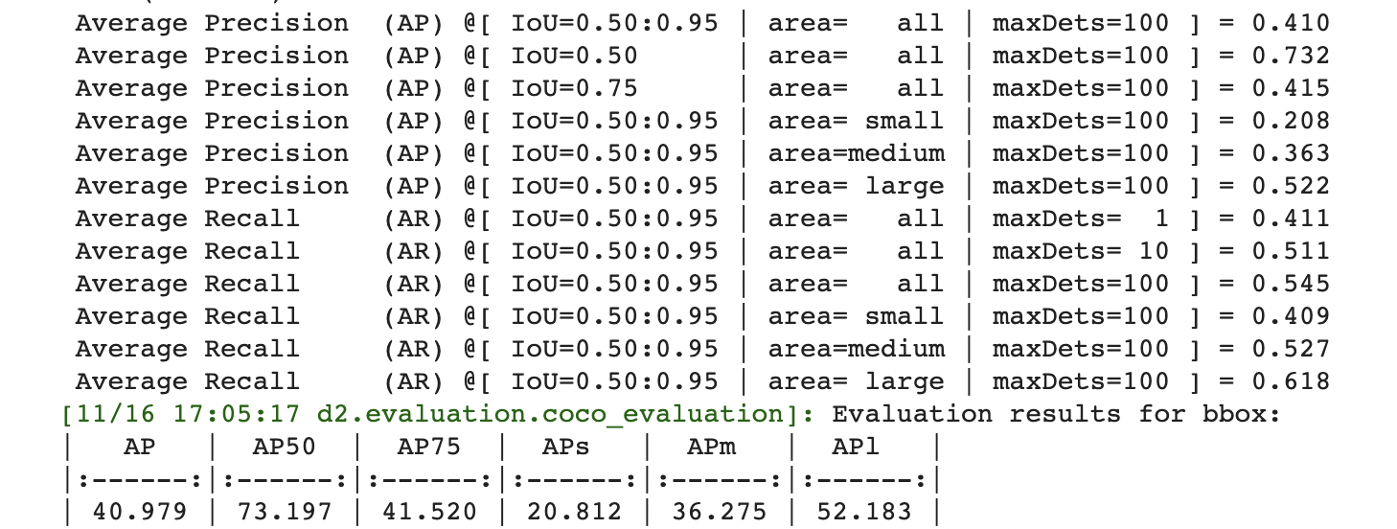
Validation set – COCO style evaluation
Notes:
Discuss here each one roughly and what they mean

Slide 12
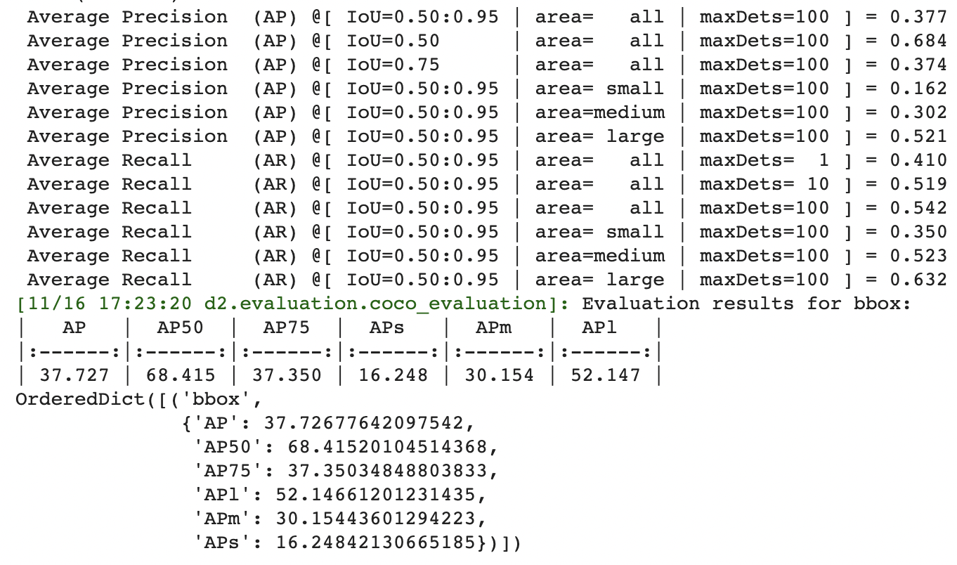
Test set – COCO style evaluation

Slide 13
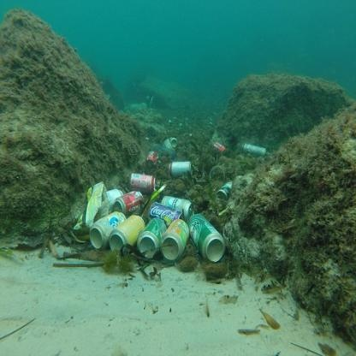
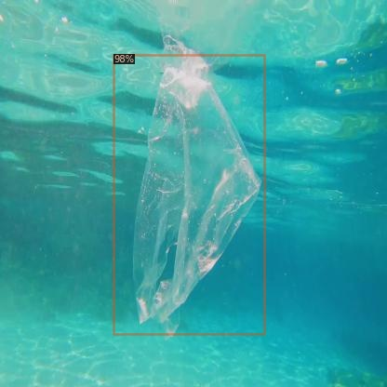
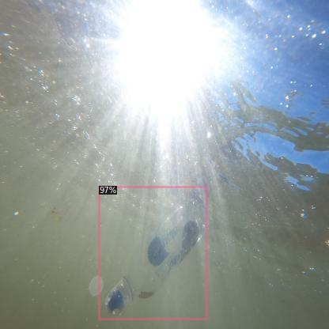
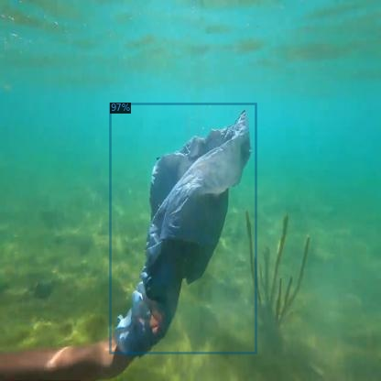
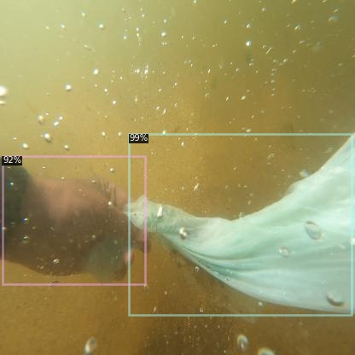
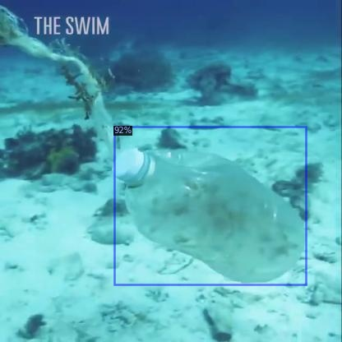
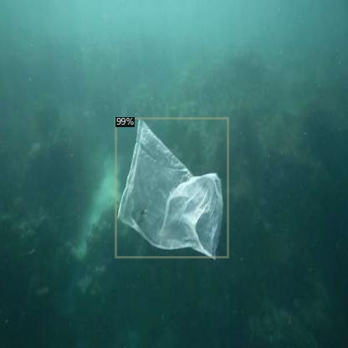
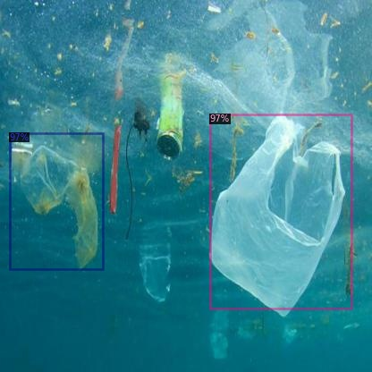
Making inferences
Notes:
Those results were at an 85 threshhold
Point at those cans how it didn’t detect them
Also the human hand detected
To the right are missed/confusing ones
To the left are kinda ideal

Slide 14
LIMITATIONS & CHALLENGES
TIME & TECHNICAL LIMITATIONS
DATA LIMITATIONS
MODEL LIMITATIONS
The model hasn’t been trained to detect sea life to be able to differentiate between the two
Static – needs to be real-time.
Validation vs training set loss not visible (Detectron2)
Didn’t get to tune the model as much
Had issues with augmentations and Detectron2
Couldn’t explore the results further
All images were RGB and from the upper open ocean layer – no deep
sea images or Sonar
Notes:
The dataset I had access consisted of photos close to the surface level - no deep sea images.
RGB images only - working with Sonar (sound navigation and ranging)
I used Detectron2 and they didn’t have a built in one so couldn’t use a loss graph to evaluate overfitting/underfitting
For the metrics/results: I want to explore this further. Why was the AP like this? Etc. Are bigger objects more or less likely to be detected than smaller objects? - There are some packages that investigate this further however I had issues getting them to work and there wasn’t enough time to solve that

Slide 15
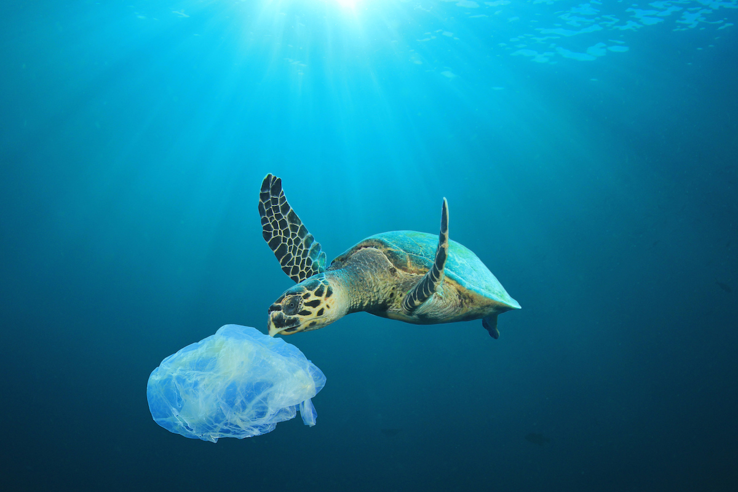
FUTURE PLANS
Tuning the model further.
Trying other models/architectures and libraries.
A more varied dataset.
Considering the size of the objects.
Notes:
Realistically, I’m aware my technical inexperience meant I couldn’t do a lot of things – some probably didn’t even consider. But that also means there’s lots of room for improvement once I get better so that’s good
There might be steps I’m missing that could exponentially improve the model so I’m looking forward to digging in later with more time and less stress about deadline
Also about the size: I think focusing on certain sizes might be better considering the capacity for removal (bigger: less chance of sea life entanglement ;;; smaller: protecting marine life from tiny objects that they’re likely to swallow

Slide 16
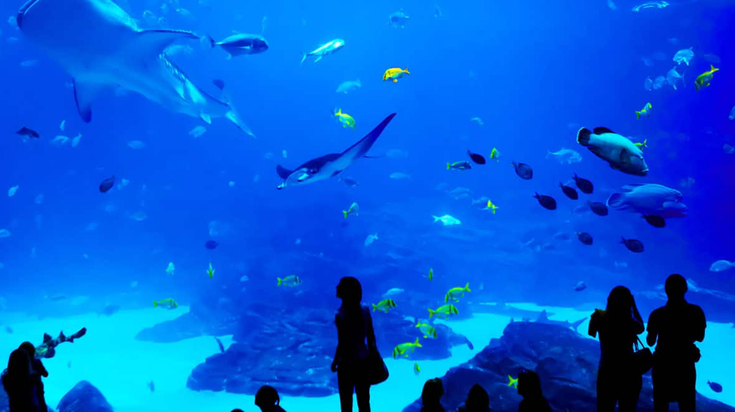
POTENTIAL FURTHER APPLICATIONS
Aquarium maintanance and cleaning
Pool maintanance and cleaning
Notes:
Mention that it’d have to be trained again with different targets for those

Slide 17
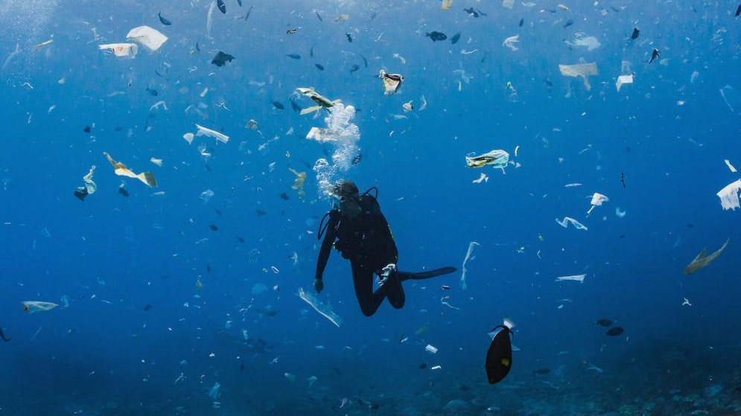
To conclude…
Notes:
Bring up abdullah bringing up the cleaning ship

Slide 18



Thank you,

Slide 19
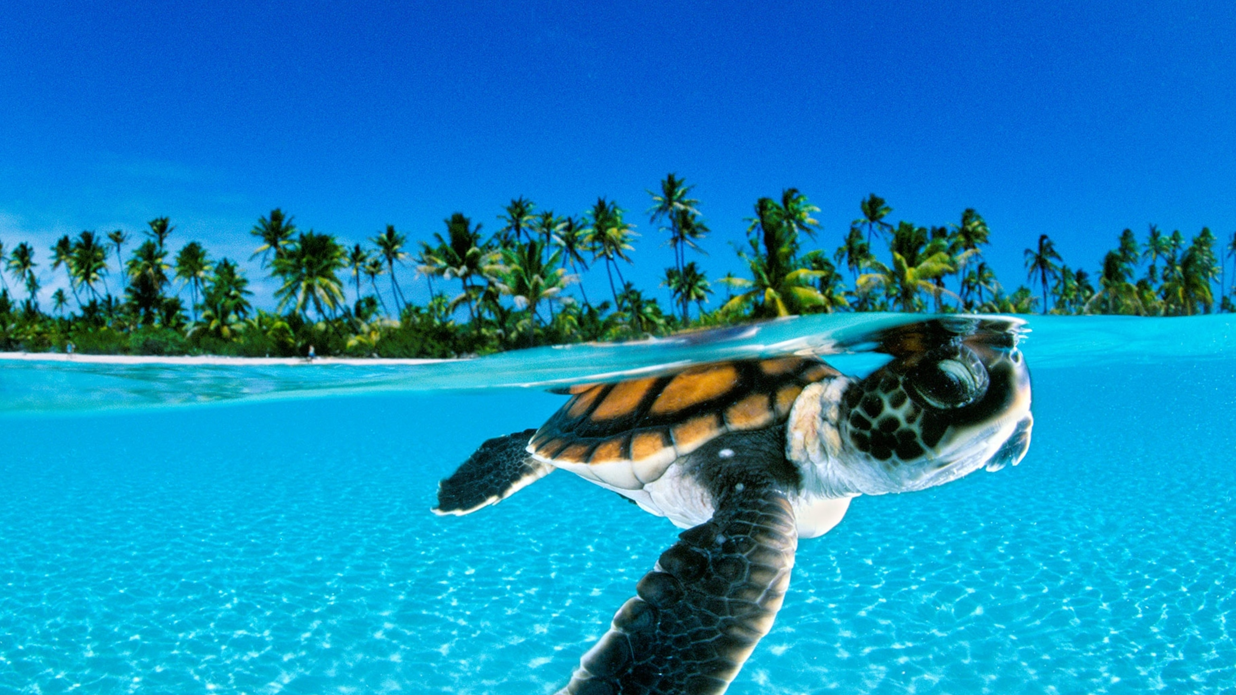
Thank you, Rick Scavetta
Lujain Felemban

Slide 20
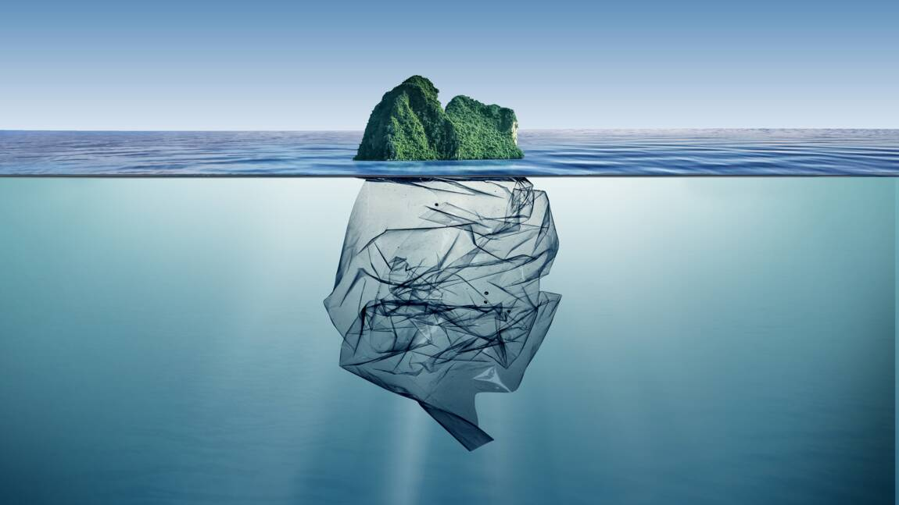
And thank you for listening!
Quesitons?

